Slide 1

MARTA
FY 2025
PROPOSED
OPERATING BUDGET BRIEF
May 2024
Division of Finance
Office of Budget & Grants

Slide 2
FY25 PROPOSED OPERATING BUDGET
Table of Contents
  Authority Summary
    Strategic Priorities 3
    Authority Organizational Chart 4
    Authority Projected Operating Revenues 5
    Authority Proposed Operating Expenses 6
    Authority Summary 7
    Departmental Expense Summary 8
    Largest Contracts – Operating 9
  Departmental Summaries
    Dept of General Manager CEO 10
    Dept of Internal Audit 11
    Dept of Police Services 12
    Dept of Chief Counsel Legal Services 13
    Dept of Deputy Chief Legal Counsel 14
    Dept of Information Security 15
    Dept of Chief Safety & Quality Assurance 16
    Dept of Safety & Quality Assurance 17
    Dept of Deputy General Manager 18
    Dept of Bus Operations 19
    Dept of Mechanical Operations 20
    Dept of Rail Operations 21
    Dept of Chief of Capital Programs 22
    Dept of Deputy Chief Capital Programs Expansion & Innovation 23
    Dept of Centralized Program Management Office 24
    Dept of Strategic Projects 25
    Dept of Capital Programs Delivery 26
    Dept of Planning 27
    Dept of Infrastructure 28
    Dept of Real Estate Development & Asset Management 29
    Dept of Chief of Staff and Administration 30
    Dept of External Affairs 31
    Dept of Labor and Employee Relations 32
    Dept of Human Resources 33
    Dept of Chief Financial Officer CFO 34
    Dept of Finance 35
    Dept of Chief Customer Experience and Technology 36
    Dept of Technology 37
    Dept of Customer Experience & Strategy 38
    Dept of Research and Analysis 39
    Dept of Inventory Adjustment 40
  Appendix
    MARTA Fare History 41
    Fare Structure 42

Slide 3
FY25 PROPOSED OPERATING BUDGET
Authority Summary
• Strategic Priorities •
Customer-Focused​
Create a delightful customer experience at all touchpoints of MARTA’s services​
​
Workforce Development​
Hire, train, and retain a qualified and motivated workforce that meets current ​
and future needs​
​
Operational Excellence​
Create a transit experience that is safe, secure, clean, reliable, and frequent​
​
Fiscal Responsibility​
In all areas of financial budgeting, projecting, reviewing, and optimizing, act as stewards to the citizens being served​
​
Digital Transformation​
Advance MARTA’s technology to improve operations and customer service​
​
Capital Programs​
Utilize capital programs to provide safe, reliable, and innovative services as the region’s trusted transit authority​

Slide 4
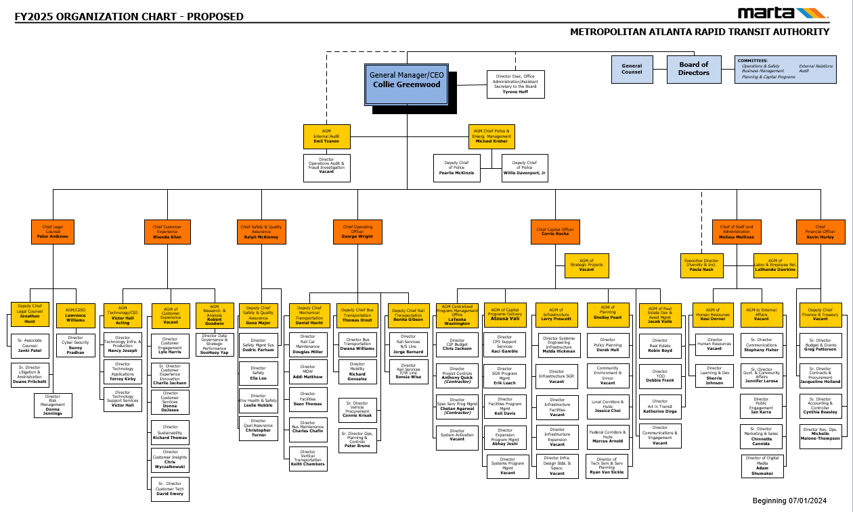

Slide 5
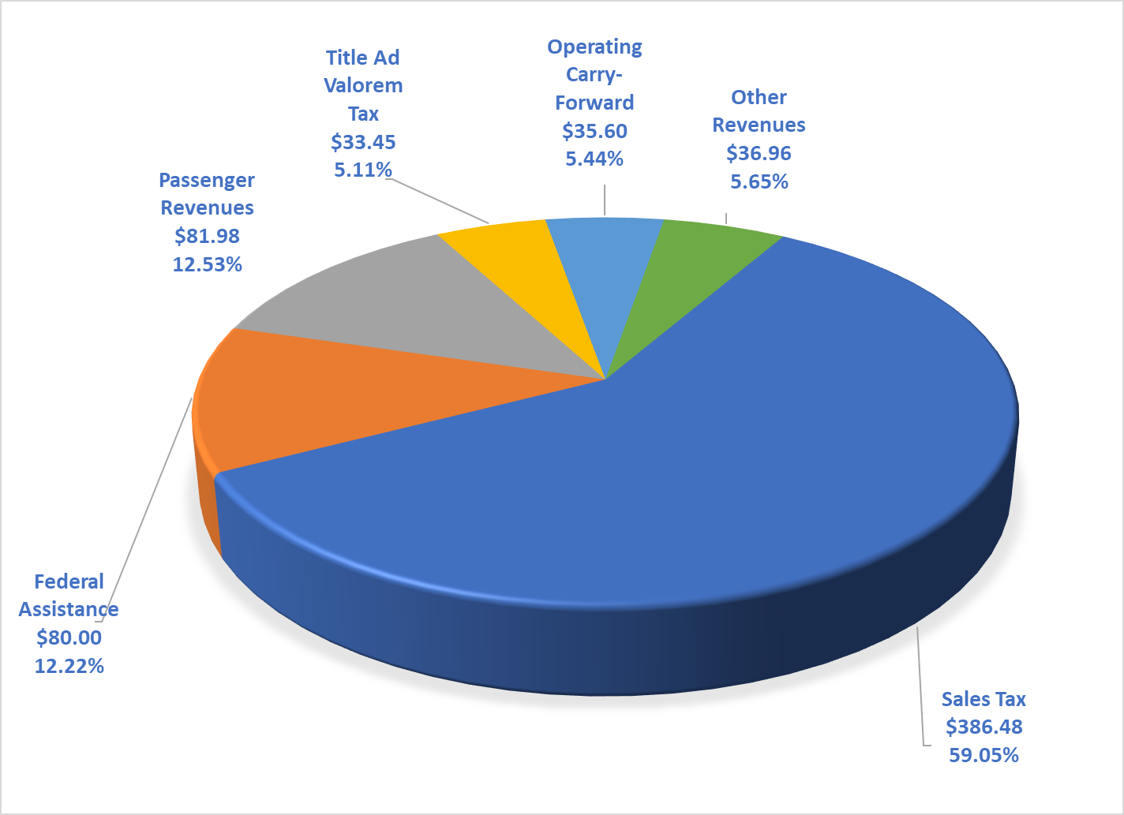
FY25 PROPOSED OPERATING BUDGET
FY25 Projected Operating Revenues
$654.5 (M)

Slide 6
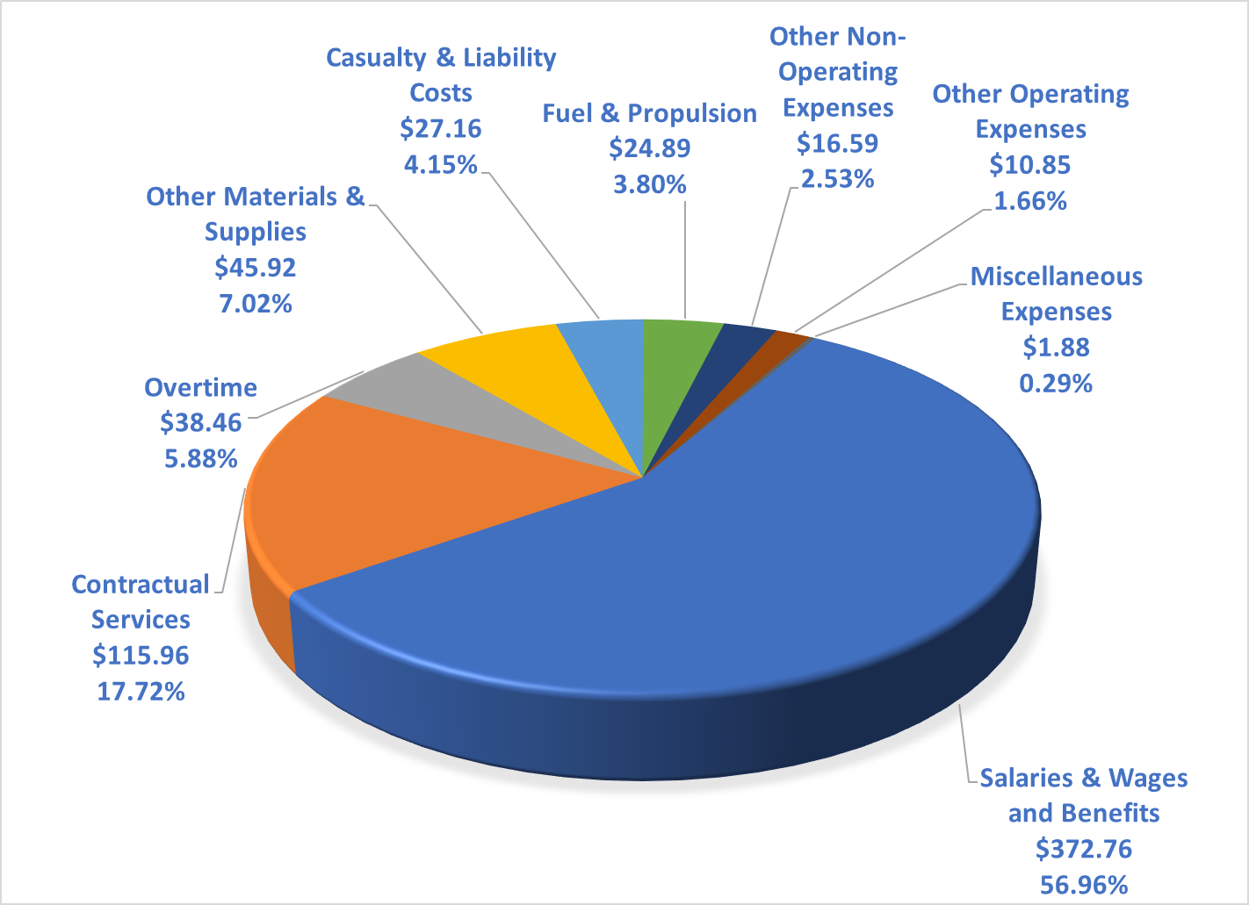
FY25 PROPOSED OPERATING BUDGET
FY25 Proposed Operating Expenses
$654.5 (M)

Slide 7
FY25 PROPOSED OPERATING BUDGET
Authority Summary

Slide 8
FY25 PROPOSED OPERATING BUDGET
Authority Summary

Slide 9
FY25 PROPOSED OPERATING BUDGET
LARGEST OPERATING BUDGET CONTRACTS

Slide 10
Dept of General Manager / CEO
General Manager • Board of Directors

Slide 11
Dept of Internal Audit
AGM Internal Audit • Operations Audit & Fraud Investigations

Slide 12
Dept of Police Services
Police Services

Slide 13
Dept of Chief Counsel Legal Services
Chief Counsel Legal • Litigation & Administration • Risk Management

Slide 14
Dept of Deputy Chief Legal Counsel
Deputy Chief Legal Counsel • Corporate Law

Slide 15
Dept of Information Security
AGM of Information Security • Cyber Security

Slide 16
Dept of Chief Safety & Quality Assurance
Chief of Safety & Quality Assurance • Safety Management Systems

Slide 17
Dept of Safety & Quality Assurance
Deputy Chief of Safety & QA • Safety • Quality Assurance • Environment Health & Safety

Slide 18
Dept of Deputy General Manager
Deputy General Manager • Vehicle Procurement • Operations Planning & Control

Slide 19
Dept of Bus Operations
Deputy Chief of Bus Operations •
Bus Transportation • Bus Maintenance • Mobility

Slide 20
Dept of Mechanical Operations
Deputy Chief of Mechanical Operations • Rail Car Maintenance • Maintenance of Way • Bus Maintenance • Vertical Transportation • Facilities

Slide 21
Dept of Rail Operations
Deputy Chief Rail Operations • Rail Services North – South Line • Rail Services East - West Line • Facilities • Vertical Transportation

Slide 22
Dept of Chief of Capital Programs
Chief of Capital Programs

Slide 23
Dept of Deputy Chief Capital Programs Expansion & Innovation
Deputy Chief Capital Programs Expansion & Innovation

Slide 24
Dept of Centralized Program
Management Office
AGM CPMO • CIP Budgeting • Project Controls • Specialized Services Program Management • System Activation

Slide 25
Dept of Strategic Projects
AGM Strategic Projects

Slide 26
Dept of Capital Programs Delivery
AGM Capital Programs Delivery • CPD Support Services • SGR Program Management • Facilities Program Management • Expansion Program Management • Systems Program Management

Slide 27
Dept of Planning
AGM Planning • Policy Planning • Community Environment & Innovation • Local Corridors & Hubs • Federal Corridors & Hubs • Technical Services & Service Planning

Slide 28
Dept of Infrastructure
AGM of Infrastructure • Systems Engineering Infrastructure • Infrastructure State of Good Repair •Infrastructure Facilities • Infrastructure Expansion • Infrastructure Design Stds & Specs

Slide 29
Dept of Real Estate Development & Asset Management
AGM Real Estate Development & Asset Management • Transit Oriented Development & Real Estate • Real Estate Development • Art In Transit

Slide 30
Dept of Chief of Staff and Administration
Chief of Staff and Administration • Diversity and Inclusion

Slide 31
Dept of External Affairs
AGM External Affairs • Communications • Government Affairs • Public Engagement • Marketing & Sales

Slide 32
Dept of Labor & Employee Relations
AGM Labor & Employee Relations

Slide 33
Dept of Human Resources
AGM Human Resources • Human Resources • Learning & Development

Slide 34
Dept of Chief Financial Officer / CFO
Chief Financial Officer CFO • Budget & Grants • Dir Contracts & Procurement

Slide 35
Dept of Finance
Deputy Chief of Finance & Treasury • Accounting • Revenue Operations • Parking Services

Slide 36
Dept of Chief of Customer Experience & Technology
Chief of Customer Experience & Technology

Slide 37
Dept of Technology
AGM Technology CIO • Technology Applications • Technology Infrastructure & Production • Technology Support Services

Slide 38
Dept of Customer Experience & Strategy
Customer Experience & Strategy • Customer Experience Innovation • Customer Service • Sustainability • Customer Technology • Customer Insights • Customer Engagement

Slide 39
Dept of Research and Analysis
AGM of Research and Analysis • Strategic Performance & Data Management

Slide 40
FY24 PROPOSED OPERATING BUDGET
Dept of Inventory Adjustment

Slide 41
FY24 PROPOSED OPERATING BUDGET
APPENDIX
MARTA Fare History

Slide 42
FY24 PROPOSED OPERATING BUDGET
APPENDIX
MARTA Fare Structure

Slide 43
FY24 PROPOSED OPERATING BUDGET
APPENDIX
MARTA Fare Structure

Slide 44
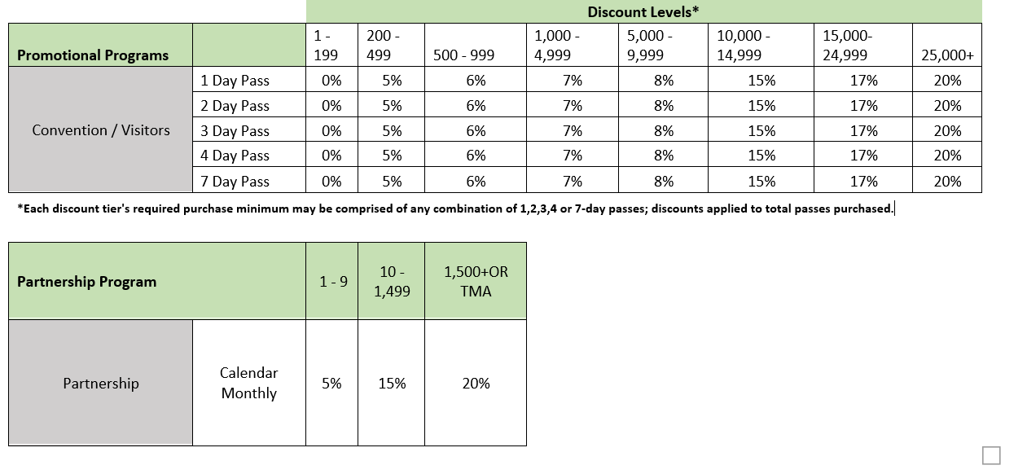
FY24 PROPOSED OPERATING BUDGET
APPENDIX
MARTA Fare Structure

Slide 45
FY24 PROPOSED OPERATING BUDGET
APPENDIX
MARTA Fare Structure

Slide 46

APPENDIX
MARTA Fare Structure

